Slide 1
Best Practice Analytics Part 2 - Data Quality Assertions and Exploratory Analysis
Notes:
Security classification options: – Public
– Internal
– Confidential
– Highly Confidential

Slide 2

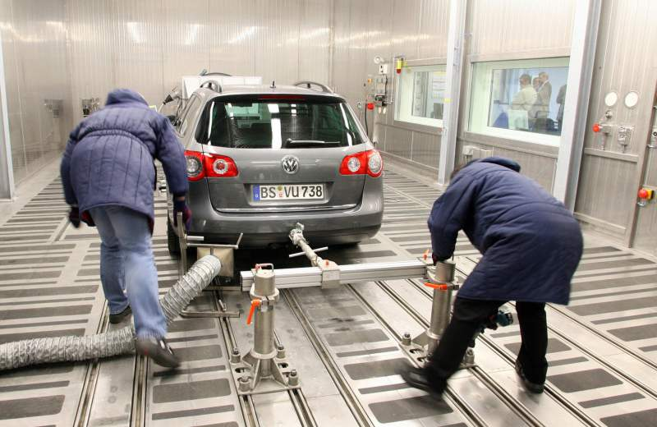
Dodgy Data

Slide 3
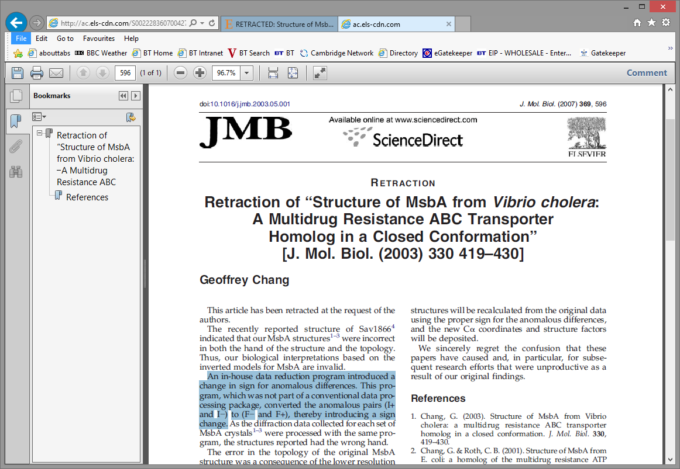
Dodgy Data

Slide 4
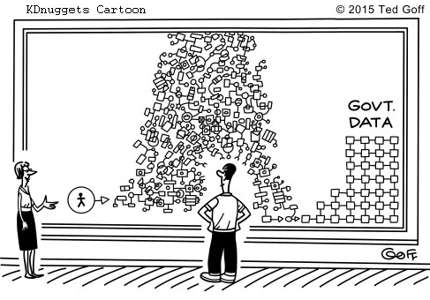
Data
“This is you, these are organisational and regulatory obstacles, and this is the operational data you want. Welcome to the Data Science Team!“
(Original at http://www.kdnuggets.com/2015/03/cartoon-us-chief-data-scientist-challenge.html)

Slide 5




Typical Data Sources in Enterprises
Databases and Data Warehouses
Spreadsheets and other documents
Operational Systems
Big Data
Cloud databases (e.g. Google Big Query, Amazon Redshift), often Oracle, but also MySQL, Postgres, MS Access etc. Often hidden behind reporting interfaces.
Data is hidden away in stores used by systems.
Hadoop Environments.
Data in various proprietary formats in various types of documents. Data can be structured (tables, XML,…) or unstructured (text, images,…)

Slide 6
“Your ML model is only as good as the data that goes into it. So an important part of ML is engineering great features.” (Cassie Kozyrkov: Making Friends with Machine Learning)

Slide 7
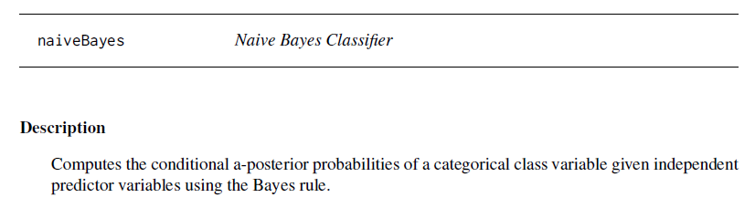
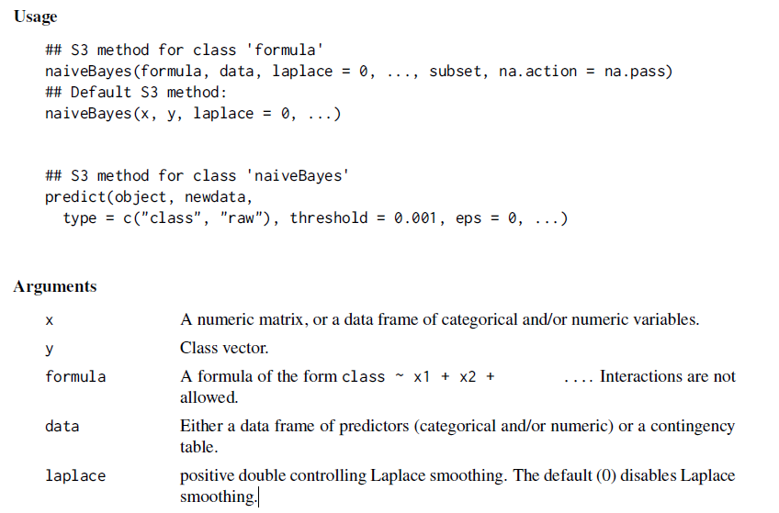
A Report from the Coalface: Naïve Bayes in R

Slide 8
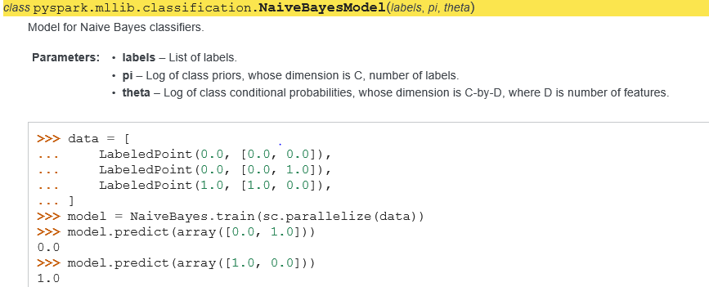
A Report from the Coalface: Naïve Bayes in Spark ML

Slide 9
A Report from the Coalface: From R to Spark ML
A team of developers/analysts build a naïve Bayes classifier in R (e1071 package) using numerical and categorical features
They couldn’t use the model to score the data in a Hadoop environment and had to rebuilt the model in Spark ML
The Spark ML method can only use categorical features encoded as numbers (the team interpreted this as any numbers are fine, i.e. numerical features can be used too)
The team converted the categorical features into numbers and kept the numerical features as they were
Luckily they had negative values in their numerical features which the Spark ML method refused to accept – this is when they asked for help…

Slide 10
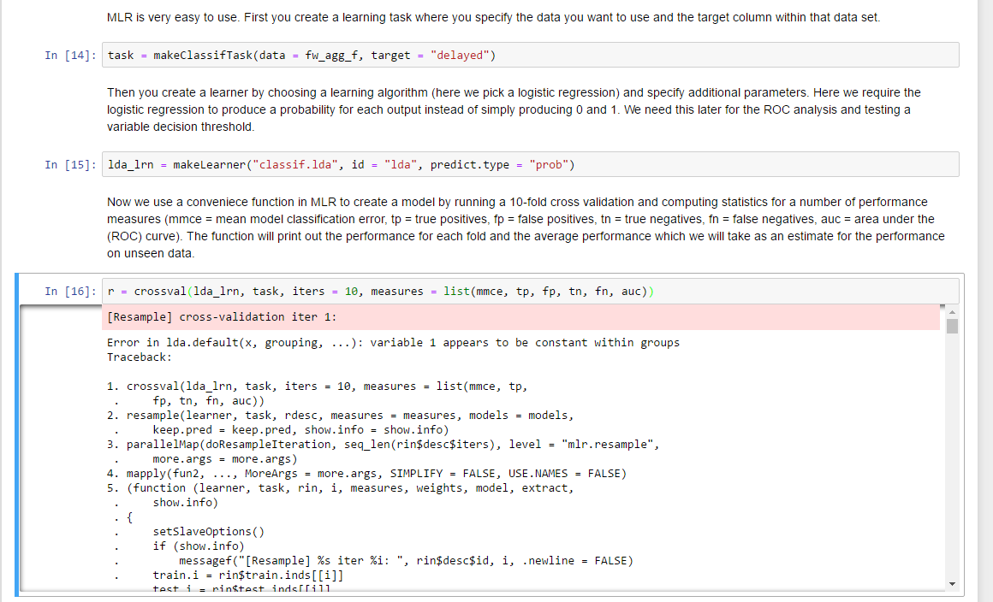
Some Learning Algorithms Complain about Wrong Data

Slide 11
Data Quality Issues in Enterprises
Most data sources in enterprises support operational systems (process workflow, CRM systems etc)
Operational data schemas are often not designed for analytics
Data is typically distributed across silos and access can be difficult (administrative and computational obstacles)
Joining data across operational domains is often error prone due to data inconsistencies
Working with real world data requires a lot of data wrangling and careful checking for errors and inconsistencies.
It won’t get better (human nature, operational pressure, lack of business case)
Effort in data preparation is typically 80%-90% of project effort.

Slide 12
Test Driven Analytics
How do you make sure that your analysis is correct?
When modelling you can use testing principles like cross-validation
How do you know that your data is any good?
Learn from Software Development Test-driven development (TDD) is an advanced technique of using automated unit tests to drive the design of software and force decoupling of dependencies. The result of using this practice is a comprehensive suite of unit tests that can be run at any time to provide feedback that the software is still working (Microsoft: Guidelines for test-driven development) https://msdn.microsoft.com/en-us/library/aa730844(v=vs.80).aspx
Try to assume a test-driven approach for analytics and data wrangling

Slide 13
Testing in Data Science
Data quality/correctness in repositories Use checks/triggers/assertions to prevent wrong data to be added, alarm when data does not arrive as expected, alarm when data structure changes, detect bias, …
Data in analytic workflows Use assertions to prevent errors during wrangling, ensure new data has expected structure, stop models being applied to the wrong data, detect bias, …
Development of analytic code Use unit tests to prevent bugs
Execution of analytic code Run-time assertions to prevent data and user errors (see 2.), check that models have expected performance, …
Modelling Use cross-validation, use assertions to check for over-fitting and correct use of training/test data, detect bias, check against business case
Model deployment Monitor expected performance (e.g. assertions), use control groups, check against business case, …
Decision monitoring Are decision made based on model outputs have the desired impact, check against business case, …

Slide 14
Making Sure Your Data is Correct
When you collect data for a data analysis project you may
Use data from unknown or even untrusted sources
Use data of unknown quality
Create data sets out of other data sets
Create attributes (new features) by combining other attributes
You should make sure and document that the data you have received or have created is correct

Slide 15
Making Assertions about Data
While you pre-process your data or while you conduct exploratory data analysis you should gain some insight into properties of the data.
Think about which properties are essential and which you may want to check or guarantee before you conduct any further analysis.
Write some code (e.g. in SQL or R) to demonstrate that your data is correct.

Slide 16
Assertive Programming
In computer programming, an assertion is a statement that a predicate is expected to always be true at that point in the code.
If an assertion evaluates to false at run time, an assertion failure results, which typically causes the program to crash, or to throw an assertion exception. https://en.wikipedia.org/wiki/Assertion_(software_development)
x = 1;
assert x > 0;
x++;
assert x > 1;

Slide 17
TDDA – Test Driven Data Analysis
Python module tdda (by Nick Radcliffe, Stochastic Solutions)
Reference tests for verification of complex objects (e.g. graphs, dataframes)
Constraint discovery(!) & verification: the tdda module can generate constraints from data sets and use them to verify other data. This significantly reduces the effort needed to capture and maintain constraints.
Resources
Python TDDA library (tdda): pip install tdda or git clone https://github.com/tdda/tdda.git
Blog: http://tdda.info
YouTube: search for test driven data analysis

Slide 18
R Packages for Assertive Programming
Tony Fischetti's assertr (https://github.com/tonyfischetti/assertr)
Hadley Wickham's assertthat (https://github.com/hadley/assertthat)
Richard Cotton’s assertive (https://bitbucket.org/richierocks/assertive)
Michel Lang's checkmate (https://github.com/mllg/checkmate)
Stefan Bache's ensurer (https://github.com/smbache/ensurer)
Gaston Sanchez's tester (https://github.com/gastonstat/tester)

Slide 19
Making Assertions about Data
While you pre-process your data or while you conduct exploratory data analysis you should gain some insight into properties of the data.
Think about which properties are essential and which you may want to check or guarantee before you conduct any further analysis.
Write some code to demonstrate that your data is correct.
Question: Can this help sprinkle some semantic dust on the data?

Slide 20
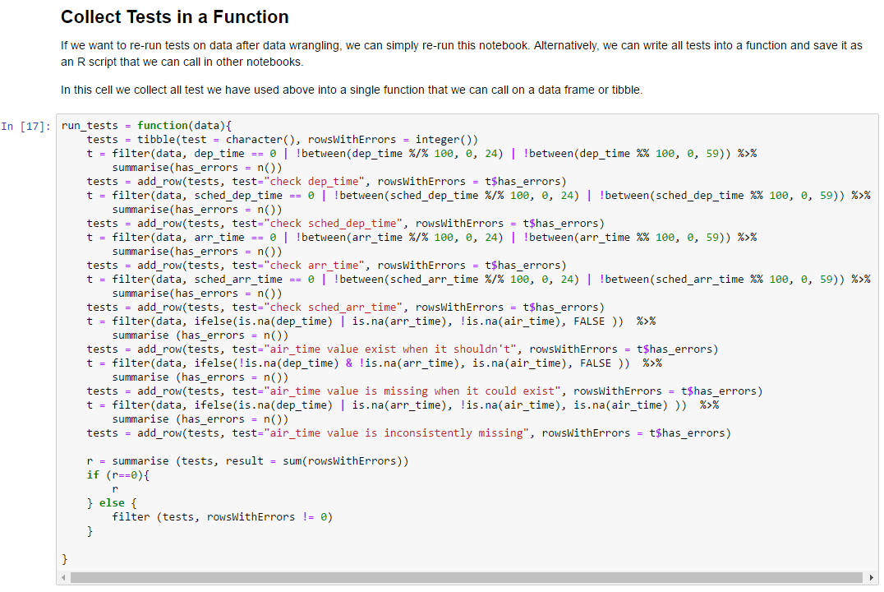
Data Quality Tests Using an R Function (nycflights13)

Slide 21
Assertive R Programming with assertr
Package assertr (by Tony Fischetti). For an introduction see https://cran.r-project.org/web/packages/assertr/vignettes/assertr.html
Main concepts
Function calls that will interrupt the execution of the current block if a condition is not met
verify() – evaluates a logical expression within the scope of a data frame
assert() – applies a predicate function (that returns true or false) to all elements of selected columns of a data frame (by using the dplyr‘s select()mechanism)
insist() – first applies a predicate generator to columns of a data frame and then tests the predicate (e.g. first compute mean and standard deviation and then test if all values are within 3 standard deviations).
assert_rows() and insist_rows() apply to all rows across selected columns
a number of predefined predicates and functions for testing (e.g. within_bounds())
Success and error functions to modify the default behaviour.

Slide 22
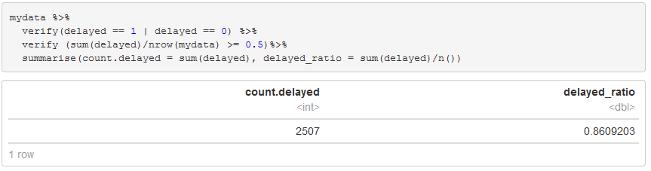
assertr – verify() tests conditions on a data frame

Slide 23
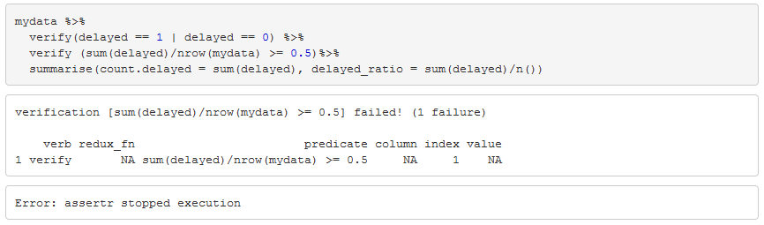
… but if it fails it cannot point to the offending value

Slide 24
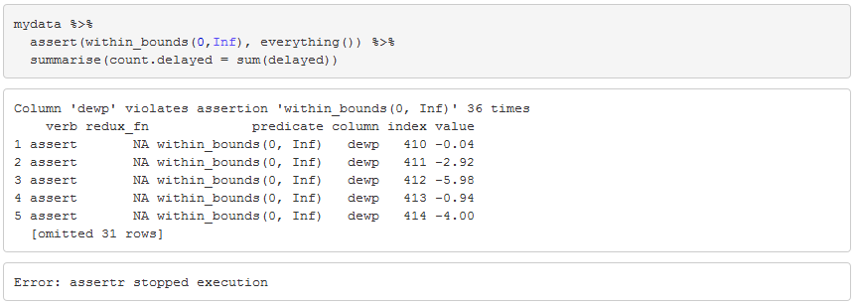
assertr – assert() tests a predicate on a list of columns (using the select() function from dplyr)

Slide 25
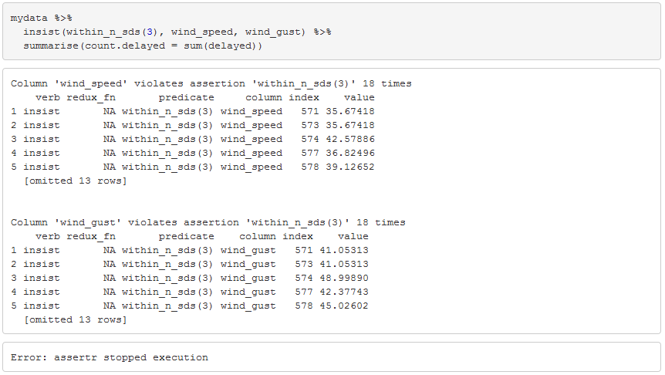
assertr – insist() dynamically determine a predicate function

Slide 26
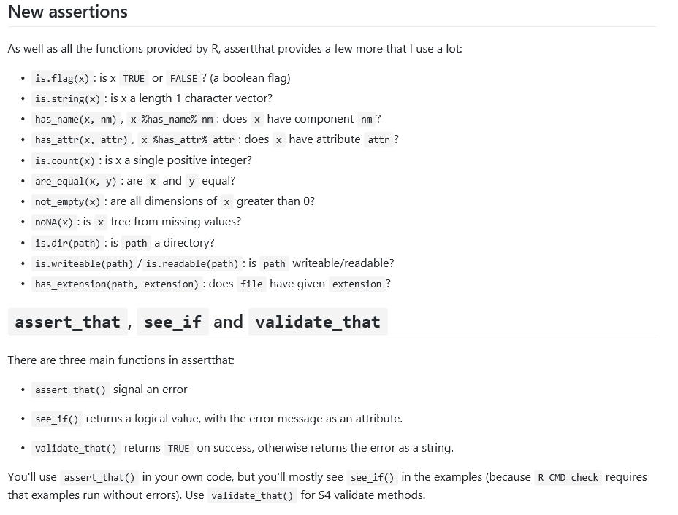
Hadley Wickham’s R Package assertthat
https://github.com/hadley/assertthat

Slide 27
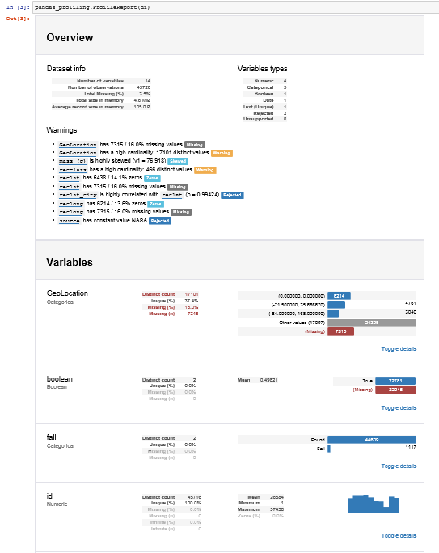
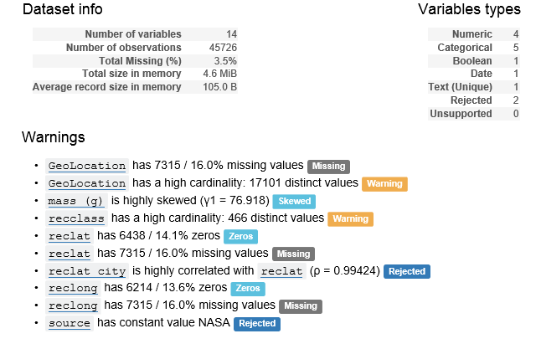
Pandas Profiling Python library https://github.com/pandas-profiling/pandas-profiling

Slide 28
TopNotch – Data Quality in a Repository (https://github.com/blackrock/TopNotch)
TopNotch is a system for testing the quality of a data set. The core of TopNotch is the assertion. Assertions are SQL where clauses that unambiguously state whether each individual data point is valid for a given condition. The rest of TopNotch allows users to organize many assertions to perform complex quality checks and to manipulate data so that it is in the correct form for assertion-based quality controls.
Terminology
Dataframe: A nested, tabular data set
Assertion: A rule command. It defines a measure of quality and filters all rows which are invalid according to that metric
Invalid: A row is considered "invalid" if it does not pass the query clause of an assertion
Failure: An assertion "fails" if the fraction of rows that it declares to be "invalid" in a data set is greater than a user-specified threshold.
View: A command that transforms one or more data sets into a single data set against which assertions can be run
Diff: A command that transforms two data sets into one by joining them on a unique key and then comparing user-specified columns
Plan: A user-defined combination of assertions, views, and diffs
Row: A single data point in a dataframe

Slide 29

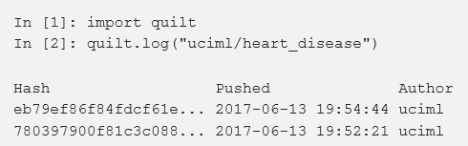
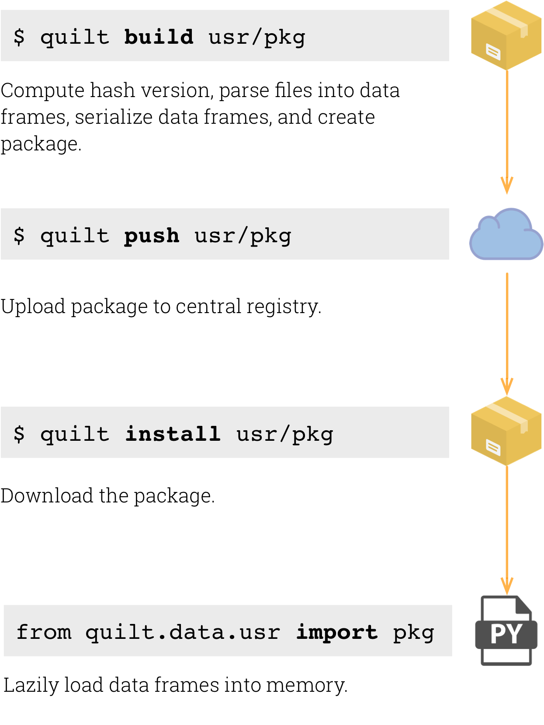
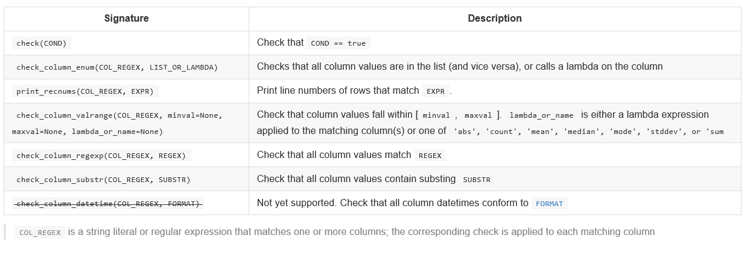
Quilt – Open Source Data Versioning Service (http://quiltdata.com)
Like code, data sets are versioned and old versions can be retrieved. Only differences are stored when a new version is checked in.
(https://blog.jupyter.org/reproducible-data-dependencies-for-python-guest-post-d0f68293a99)
(data checks are only alpha version yet)

Slide 30
Exploratory Data Analysis

Slide 31
This is about what to do when you get some data
You need to become familiar with it
This is called Exploratory Data Analysis (EDA)
In the first instance, try to find a way to plot it
Then look at various numerical summaries
I will mainly show how that works in R, but I will make references to Excel where appropriate.

Slide 32
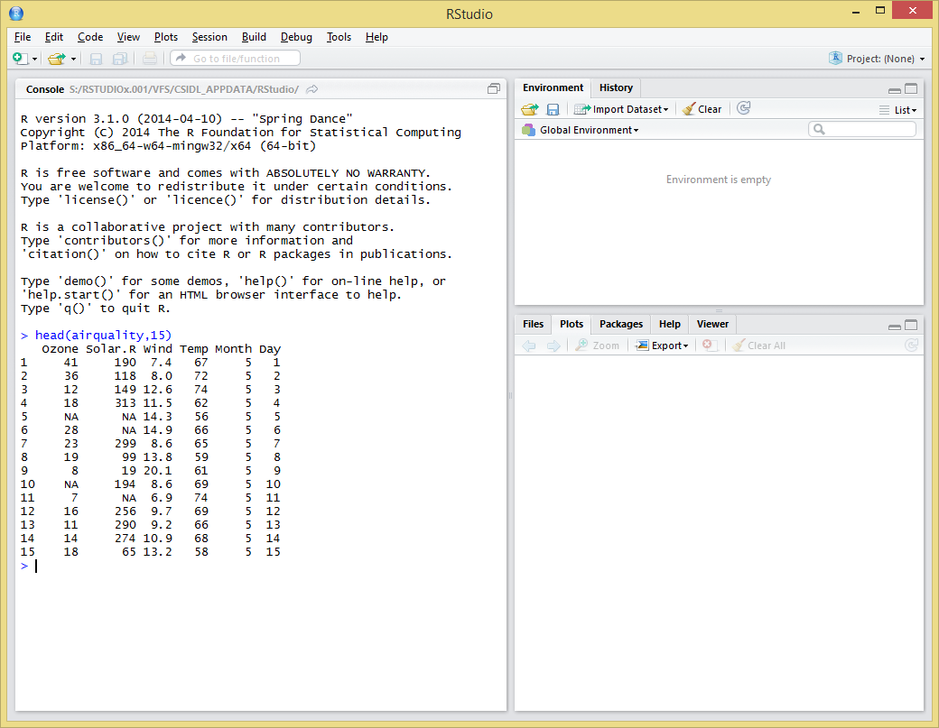
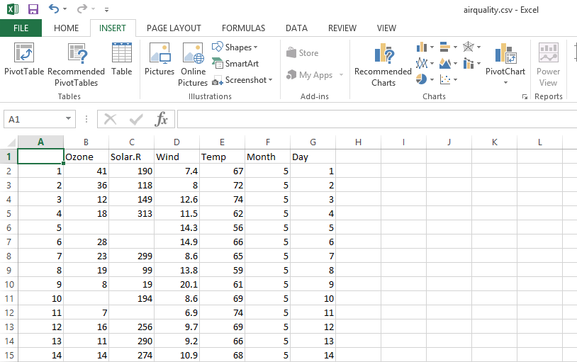
Let’s Look at Some Data

Slide 33
Let’s Look at Some Data
Different types of values
Some values are missing

Slide 34
Types of Data
 | Nominal | Ordinal | Interval Scale | Ratio Scale
What is it? | A label | Ordered values | Values with an order and distances between them | Real numbers
Examples | Type of cars: BMW, Jaguar, Fiat, … | Very Bad, Bad, OK, Good, Very Good | Time, e.g. years (…,2007, 2008, 2009, 2010,…), temperature in Celsius or Fahrenheit | All the usual physical measures, e.g. metres, kilograms, … Salary figures, …
What is meaningful? | Counting the values | Counting and ordering the values. Compare them (‘Bad’ is worse then ‘OK’) | Counting, ordering and computing differences (2007 and 2009 are two years apart) | Counting, ordering, computing differences, percentages, … There is a natural zero.
What doesn’t work? | Don’t conclude that the Bus no. 27 is bigger than the Bus no. 4 | Don’t assign number and compute averages | Don’t compute ratios or percentages. You can’t say ‘20℃ is twice as warm as 10℃’. There is no natural zero. | You’re good.

Slide 35
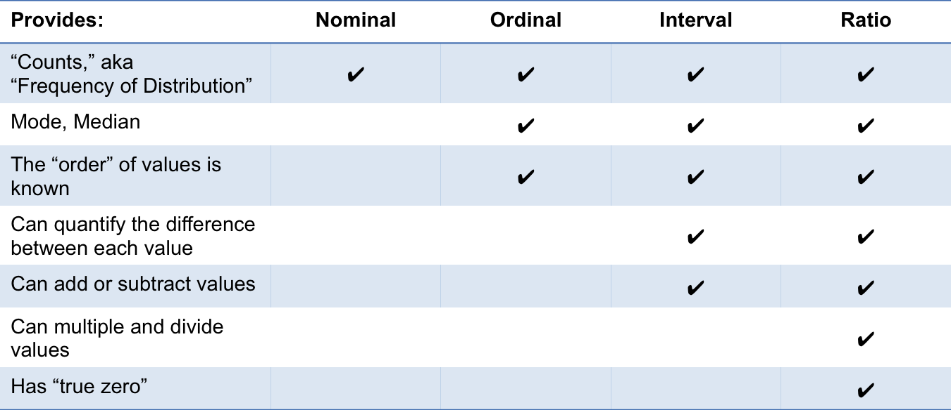
What You Can or Cannot Do

Slide 36
Some Key Points on Data Types
Always find out what the numbers in your data really represent
Most statistical analyses require at least interval-scale data
Be aware when using ordinal data that your options for analysis are a bit limited (but there are advanced methods available).
For example, responses to customer surveys are typically nominal (yes, no) or ordinal (…, good, very good, …) even if they are represented as numbers.

Slide 37
Missing Values
Missing values are common in real-world data
Excel has no symbol for missing data
Earlier versions of Excel treated blank cells as zeros if they were arguments of built-in functions
Later versions have corrected this
All versions of Excel convert blank cells to zeros if a cell is referenced first e.g. ‘=$A$2’
R uses NA as the ‘not available’ symbol. This is distinct from the string “NA”
Most statistical functions in R have options for what to do with NAs

Slide 38
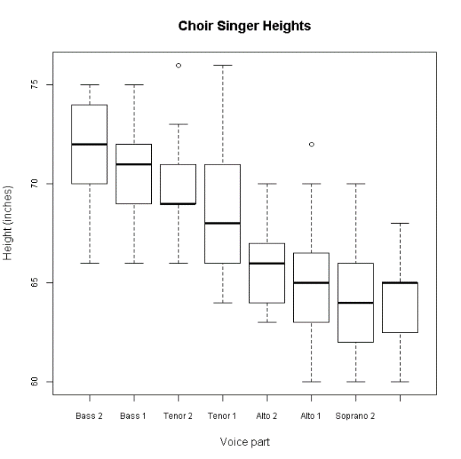
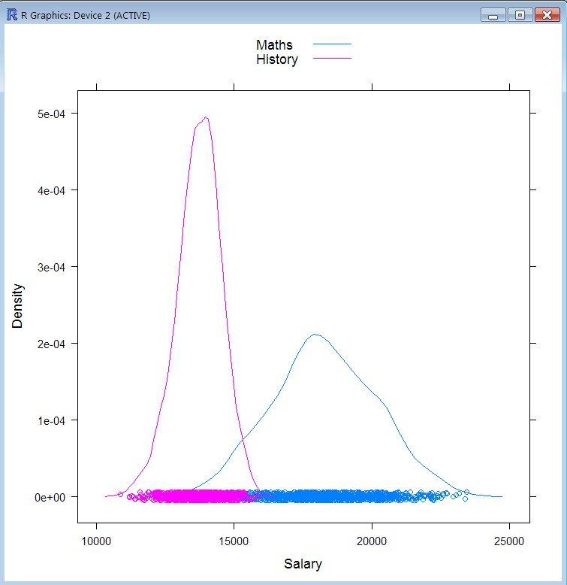
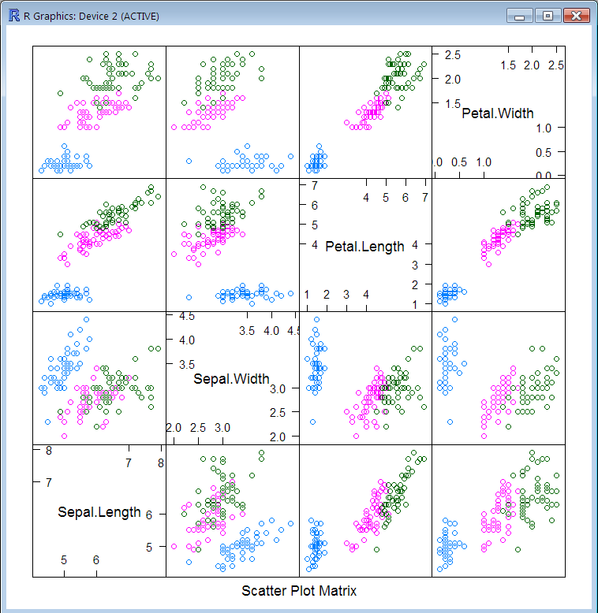
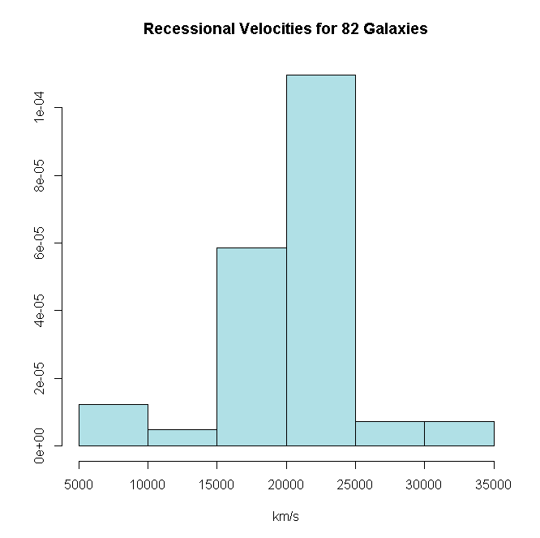
How to Become Familiar with Data
In the first instance, try to find a way to plot it
Then look at various numerical summaries (mean, median, range, standard deviation, …)
Histogram
Box and Whiskers Plot
Density Plot
Scatterplot Matrix

Slide 39
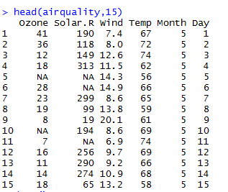
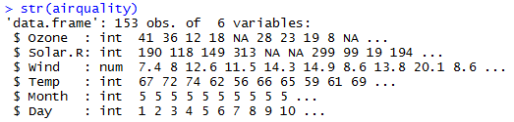
Example Data: The Air Quality Data Set
New York Air Quality Measurements (example data set built into R)
6 Variables or attributes (columns), 153 observations, cases or records (rows)
Each column contains values of a particular type of data
Each row contains values of different types belonging to one observation
R stores data in ‘Data Frames’.
Excel stores data in spreadsheets
A database stores data in tables

Slide 40
JupyTER Notebook ExamplE
The following hidden slides show basic R plot commands and are provided for reference.
Instead we work through this Jupyter Notebook on Azure: https://bestpractice2018-detlefnauck.notebooks.azure.com/nb/notebooks/Exploratory%20Data%20Analysis.ipynb

Slide 41
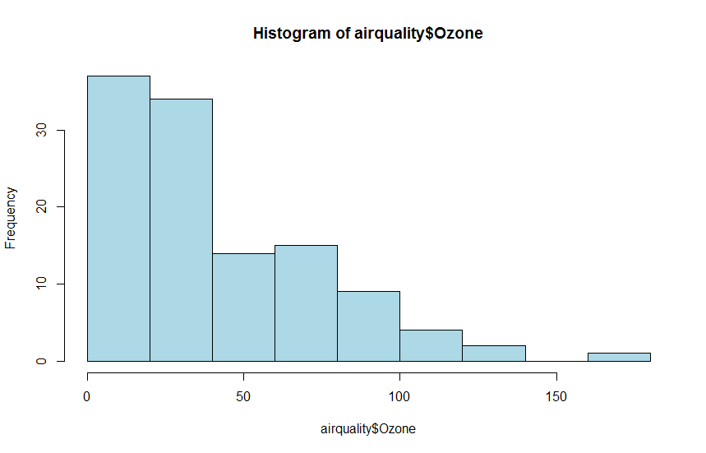
One Variable: Histograms
The value is proportional to the area of the bar, not the height
Beware: the appearance of the results is sensitive to the chosen bin width. Experiment with a few values.
In R the base function hist() does histograms. Nicer ones are also available in other packages:
lattice: histogram(),
ggplot2: qplot() with geom=“histogram”
MASS: truehist()
> hist(airquality$Ozone, col="lightblue")

Slide 42
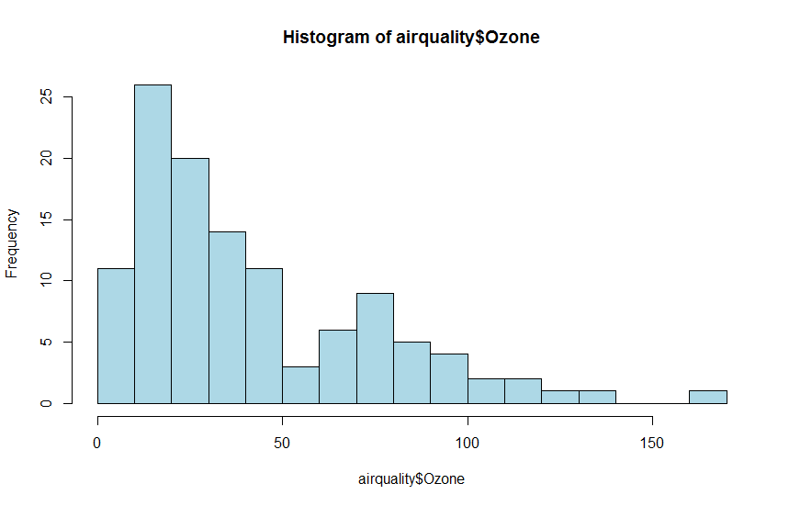
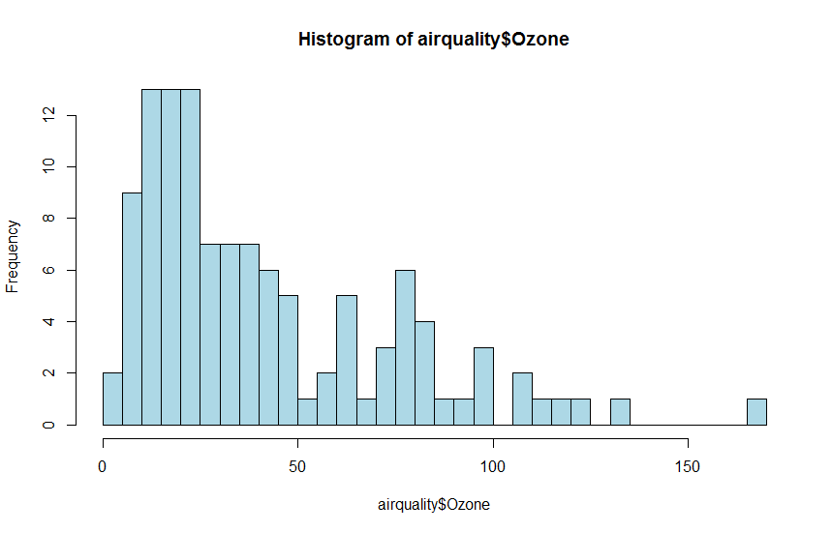
The Bin Width Determines the Level of Detail
> hist(airquality$Ozone, col="lightblue", breaks=20)
> hist(airquality$Ozone, col="lightblue", breaks=50)

Slide 43
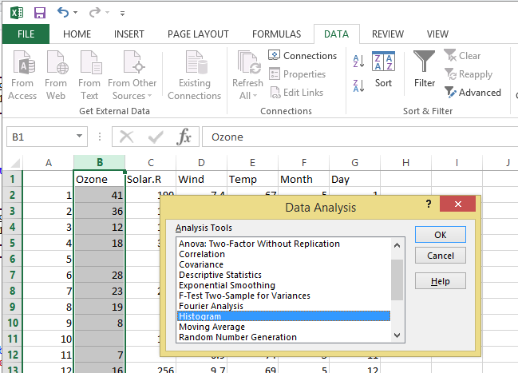
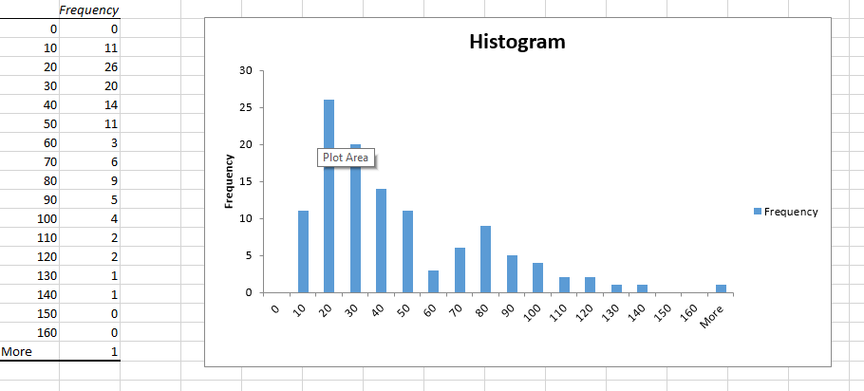
Histograms in Excel
Excel draws poor histograms. They are displayed like bar charts, which they are not. Amongst other things, it puts the x-axis labels at the class boundaries instead of between them, as if it were a bar chart. The bars don’t meet up in Excel.

Slide 44
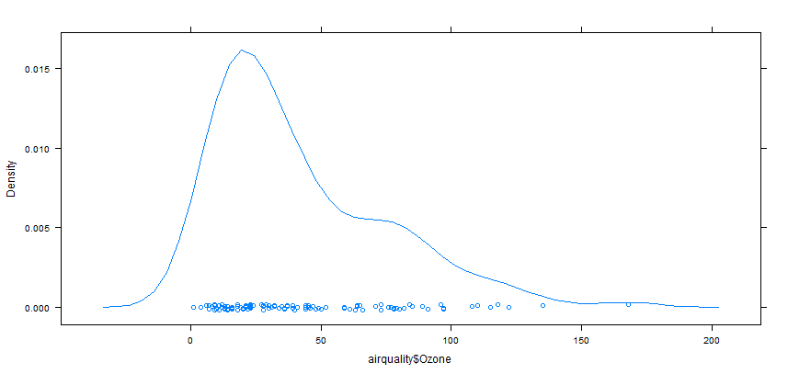
Alternative for a Histogram: Density Plot
library(lattice)
densityplot(airquality$Ozone)

Slide 45
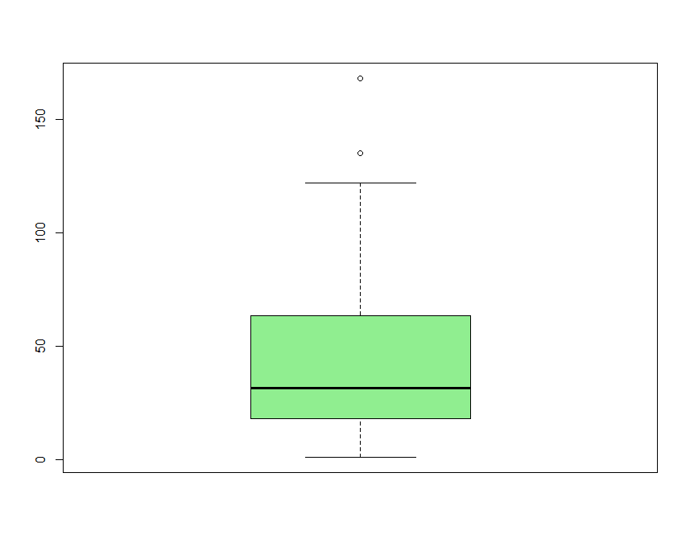
One Variable: Boxplots
The bottom of the box is the 25th percentile
The top of the box is the 75th percentile
The line across the middle is the median, or 50th percentile
The 75th percentile minus the 25th percentile is call the Interquartile Range (IQR).
Half the IQR is called the semi-interquartile range (SIQR)
By analogy with the Normal distribution, we expect most of the data to be in the range median ± 3 SIQRs and that is where we place the whiskers (unless the data does not extend that far)
Points outside the whiskers are designated as outliers and shown individually as points or lines of both
Boxplots don’t exist in Excel
> boxplot(airquality$Ozone, col="lightgreen")
Boxplots and density plots show different aspects of a distribution so it’s worth using both.
Outliers are hard to spot on density plots and histograms. Often the biggest clue is that the chosen x-scale apparently goes well beyond the data

Slide 46
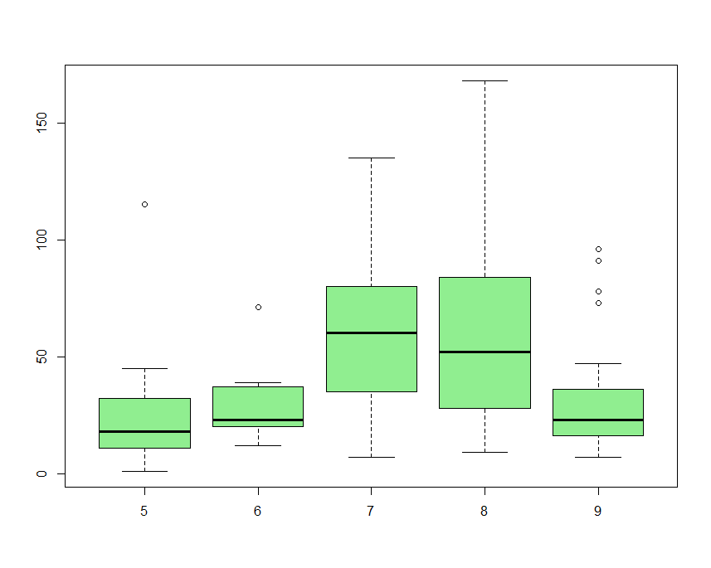
One Variable: Side-by-Side Boxplots
> boxplot(Ozone ~ Month, data=airquality, col="lightgreen")

Slide 47
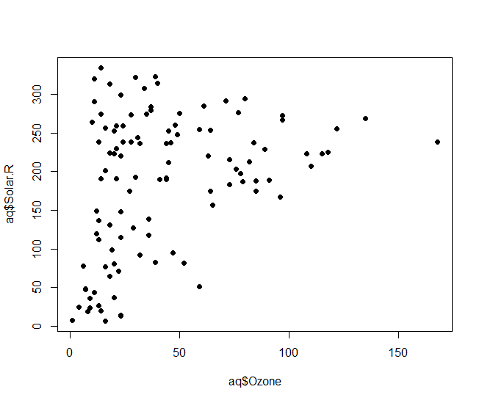
Two Variables: Scatterplot
aq = transform(airquality, Month = factor(Month))
plot(aq$Ozone, aq$Solar.R, pch=16)

Slide 48
Two Variables: Scatter Plots
Use scatter plots
to get a visual impression of correlation
look for nonlinear relationships
look for outliers

Slide 49
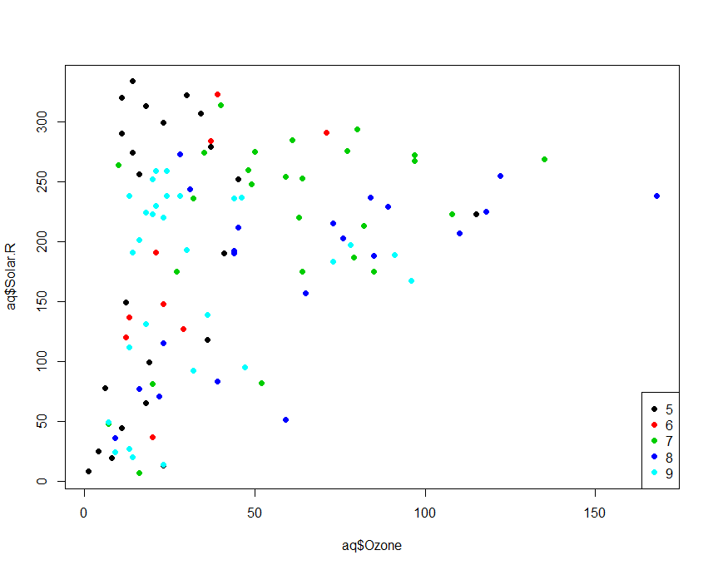
Two Variables: Scatterplot Coloured by Third Variable
outlier
aq = transform(airquality, Month = factor(Month))
plot(aq$Ozone, aq$Solar.R, pch=16, col=aq$Month)
legend(x="bottomright", pch=c(16,16,16,16,16), col=1:5, legend= levels(aq$Month))

Slide 50
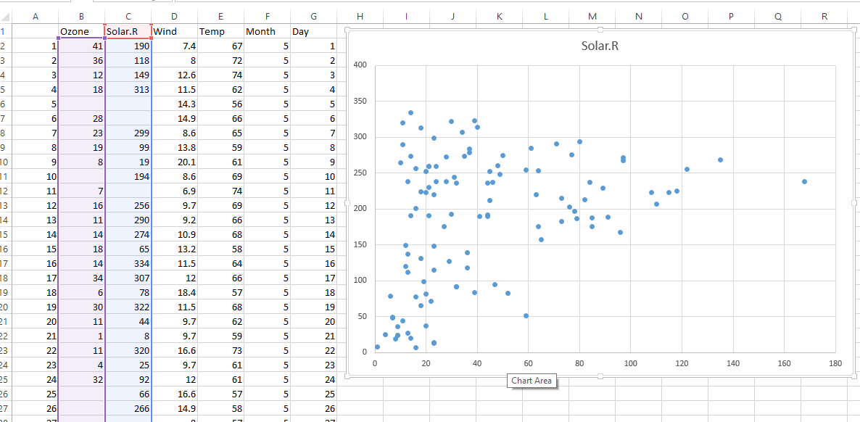
Scatterplots in Excel
In Excel you can select two numerical columns and then add a scatterplot.
Excel cannot colour the dots by a third column. You would have to split your data into different series to achieve this effect.

Slide 51
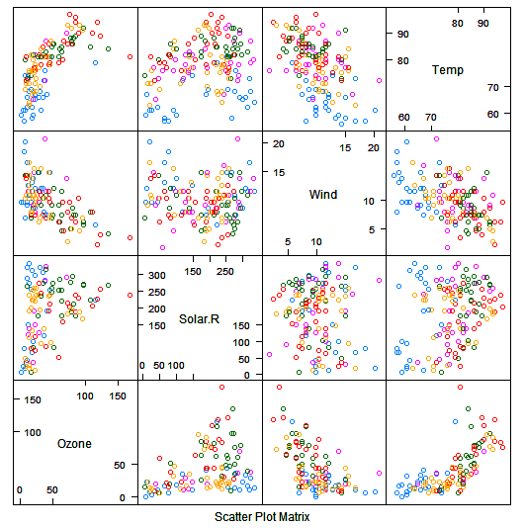
Multiple Variables: Scatter Plot Matrix
Not available in Excel
In the R base package, the command pairs() can be used, e.g. pairs(aq[1:4])
If you use the command splom() from the lattice package, you can condition the data on a factor.
This example uses the transformed airquality data set aq (see previous slide) and shows the first four columns of the data conditioned on the Month column
splom(~aq[1:4], data=aq, groups=Month)

Slide 52
Multiple Variables: Scatter Plot Matrix
Another example using the built-in data set iris.
The data consists of 3 x 50 records of three types of iris flowers.
The measurements are length and width of the flower petals and sepals.
The plot shows that one type of flower can be clearly distinguished from the other two using only one petal measurement. The other two types need at least two measurements to distinguish them and the measurements slightly overlap suggesting that some misclassifications based on this data would be unavoidable (but maybe they separate in 3- or 4-dimensional space?)
> splom(~iris[1:4], groups = Species, data = iris)
Notes:
pairs(iris[1:4])
library(lattice)
splom(~iris[1:4], groups = Species, data = iris)

Slide 53
Single-Variable Descriptions of Data
Mean
The usual average: add up and divide by the number of records
Median
50% of data points are above this, 50% below.
Coincides with the mean only if the data distribution is symmetric about the mean
Mode
the most commonly occurring value, or the highest bump on a density plot
Percentiles
Typical values are 5th, 25th, 50th (Median), 75th, 90th, 99th
Standard deviation – a measure of spread

Slide 54
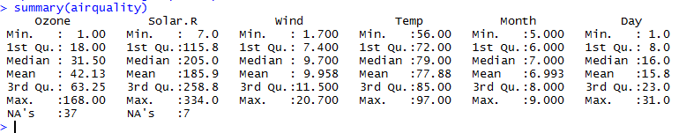
Single-value Description for an R Data Frame

Slide 55
Single-Variable Descriptions of Data
R has
mean() for means, but also colMeans()/rowMeans() for fast computation of column/row means in large data sets
sd() for standard deviations,
median() for medians
quantile() for percentile
summary() gives you minimum, 1st quartile (i.e. 25th percentile), median, mean, 3rd quartile (i.e. 75th percentile) and maximum

Slide 56
Single-Variable Descriptions of Data
Excel has:
AVERAGE() for means
STDEV.S() for sample SD and STDEV.P for population. You almost always want STDEV.S()
MEDIAN() for medians
PERCENTILE.INC() for percentiles
MIN() for the minimum
MAX() for the maximum

Slide 57
A Tip…
Never compute the mean without also computing the min and max.
The mean is very vulnerable to outliers
You may not be expecting zero or ultra-large values, but they might be in there nonetheless.

Slide 58
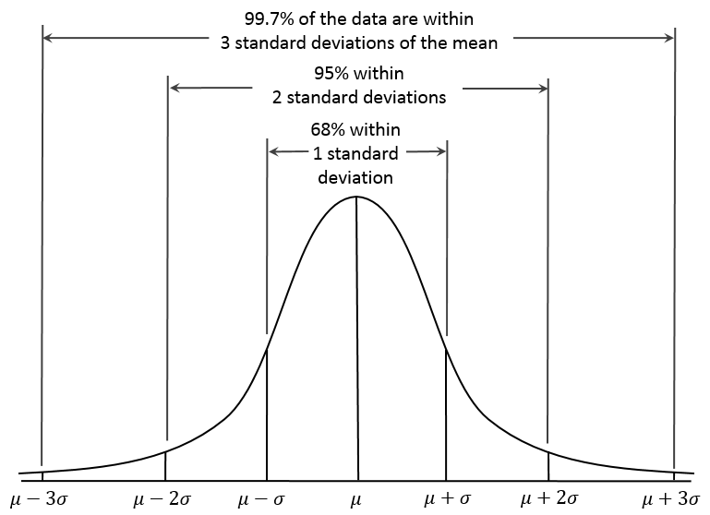
Common Distributions: The Normal Distribution
Notes:
http://commons.wikimedia.org/wiki/File:Empirical_Rule.PNG

Slide 59
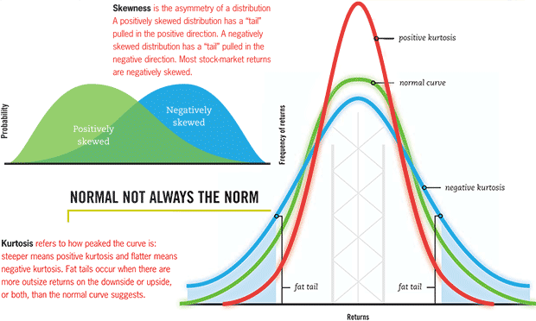
Common Distributions: The Normal Distribution

Slide 60
Summarising a Continuous Variable by One Categorical Variable
Excel has
Pivot Table that allows certain functions (COUNT, SUM, MIN, MAX, SD, VAR, AVERAGE) to be computed on subsets defined by a categorical variable
R has
apply(), lapply(), sapply() and tapply() apply a function to all elements of a matrix row/column, list or data frame respectively. tapply does it by a factor (like a pivot table) but they all do it for all available functions in R, including user-defined functions
aggregate is similar but to *apply() but faster, with different syntax
The plyr package is for more general tasks of the form ‘split the data, process it, then rebuild’. It is slow on large data sets however

Slide 61
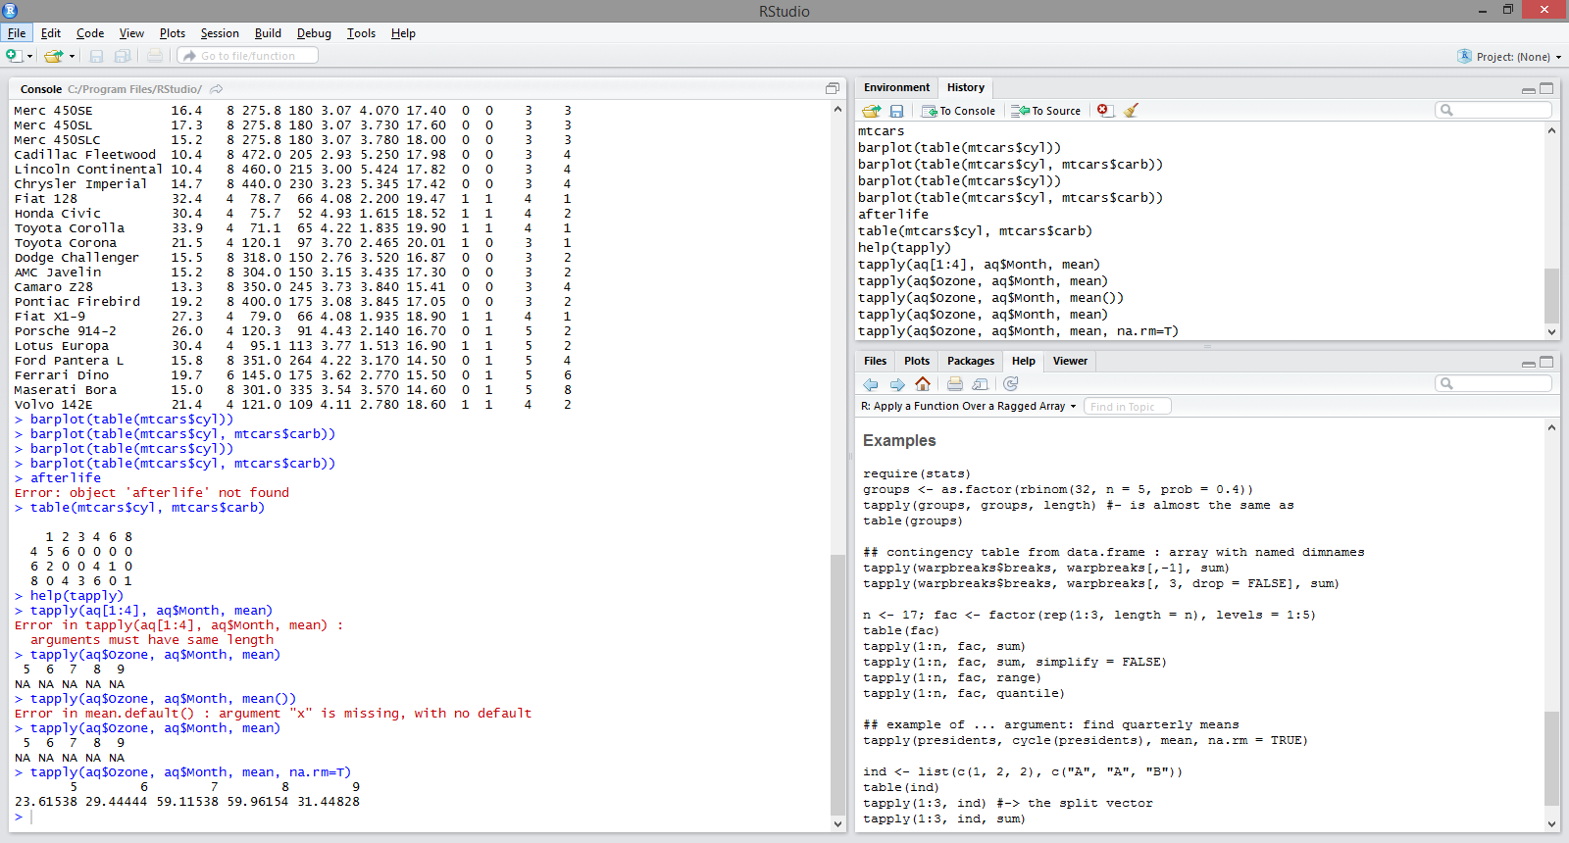
Computing Group Means in R
The Ozone column contains missing values (NAs). By default the mean() function will return NA if the data has missing values.
Here, we specify na.rm=T to tell the mean() function to ignore rows with missing values

Slide 62
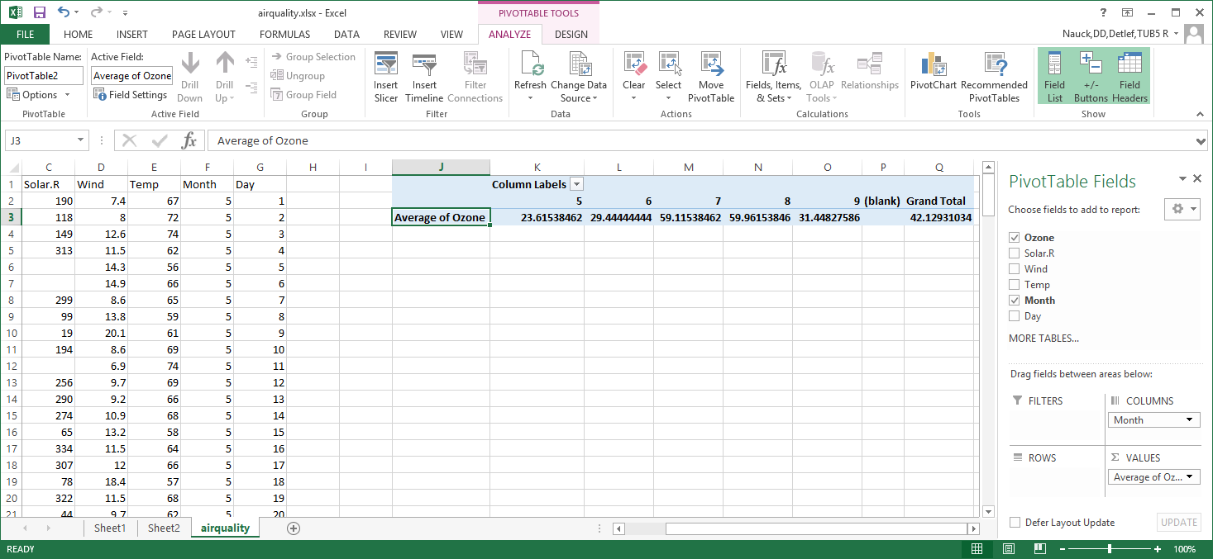
Computing Group Means in Excel using a Pivot Table

Slide 63
Confidence Intervals
The presence of randomness in data presents some problems for analysis
All branches of applied science have the need to distinguish real differences from those caused by random error.
It is important to express the uncertainty of an estimate as well as the estimate itself. This can be done with confidence intervals.
Example: How reliable are the monthly average Ozone values?

Slide 64
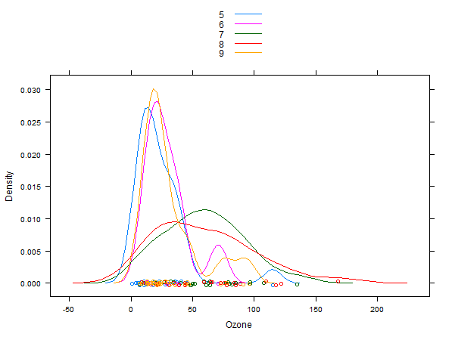
Ozone Density Plots by Month
> densityplot(~Ozone, data=aq, groups=Month, auto.key = T)

Slide 65
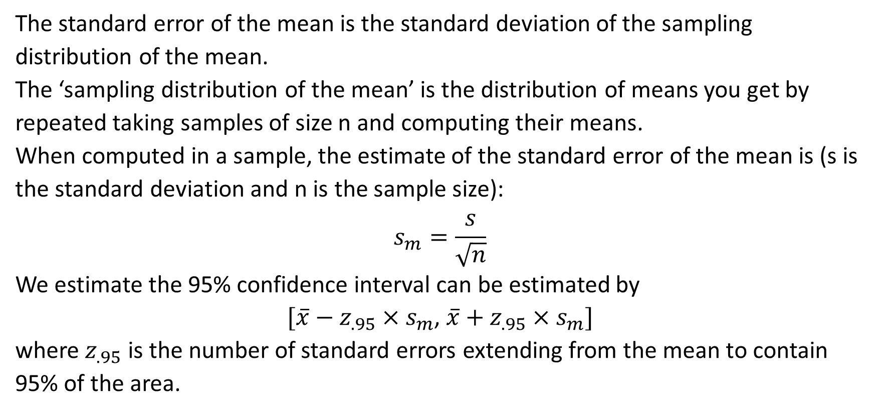
Standard Error of the Mean
The standard error of the mean is the standard deviation of the sampling distribution of the mean.
The ‘sampling distribution of the mean’ is the distribution of means you get by repeated taking samples of size n and computing their means.
When computed in a sample, the estimate of the standard error of the mean is (s is the standard deviation and n is the sample size):
$$s_{m}=\frac{s}{\sqrt{n}}$$
We estimate the 95% confidence interval can be estimated by
${[\overline{x}−z_{.95}×s}_{m}$, ${\overline{x}+z_{.95}×s}_{m}]$
where $z_{.95}$ is the number of standard errors extending from the mean to contain 95% of the area.
Notes:
The ‘sampling distribution of the mean’ is the distribution of means you get by repeated taking samples of size n and computing their means.

Slide 66
R Function to Compute 95% Confidence Interval of the Mean
> std_err = function(x){
c(
mean(x,na.rm=T)+qt(0.025,length(x[!is.na(x)])-1)*
(sd(x,na.rm=T)/sqrt(length(x[!is.na(x)]))),
mean(x, na.rm=T)+qt(0.975,length(x[!is.na(x)])-1)*
(sd(x,na.rm=T)/sqrt(length(x[!is.na(x)])))
)
}
The function excludes missing values from the calculation of the mean and standard deviation (sd).
length(x[!is.na(x)] is the sample size n without missing values
qt computes the quartiles of the t distribution which is used instead of the quartiles of the normal distribution because we can have a small sample.
Notes:
std_err = function(x){c(mean(x,na.rm=T)+qt(0.025,length(x[!is.na(x)])-1)*(sd(x,na.rm=T)/sqrt(length(x[!is.na(x)]))), mean(x, na.rm=T)+qt(0.975,length(x[!is.na(x)])-1)*(sd(x,na.rm=T)/sqrt(length(x[!is.na(x)]))))}

Slide 67
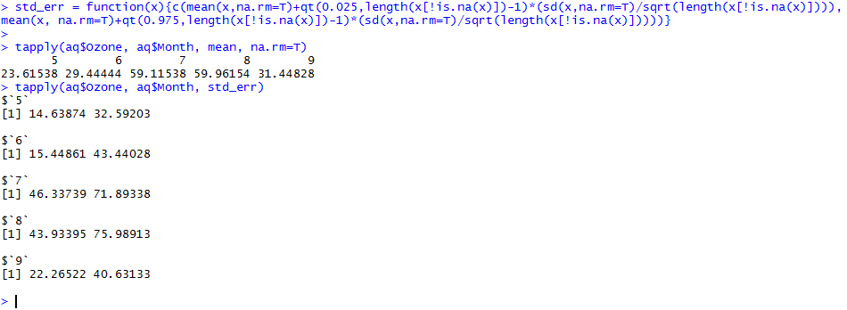
Computing 95% Confidence Intervals for the Monthly Mean Ozone Measurements

Slide 68
Multiple Categorical Variables: Contingency Tables
Shows frequency counts in cross-tabulations
In Excel, use pivot table to count values
In R use table()
Contingency tables can be analysed for association between rows an columns using the chi-squared test

Slide 69
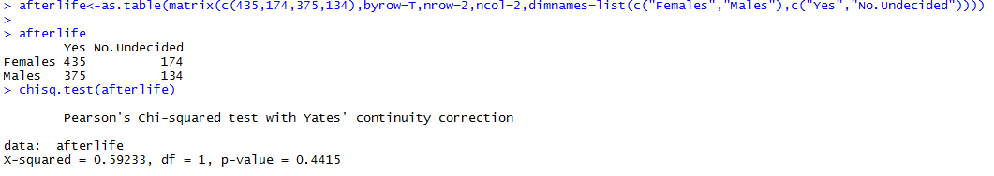
Example: Cross-classification of Belief in Afterlife by Gender
The χ² test is used to see if females are significantly different from males in their belief in Afterlife. The p-value is greater than 0.05, so the difference is not statistically significant.
Notes:
The first command creates the variable afterlife as a table from a data matrix with row and column names
>afterlife = as.table(matrix(c(435,174,375,134),byrow=T,nrow=2,ncol=2,dimnames=list(c("Females","Males"),c("Yes","No.Undecided"))))
> afterlife
> chisq.test(afterlife)

Slide 70
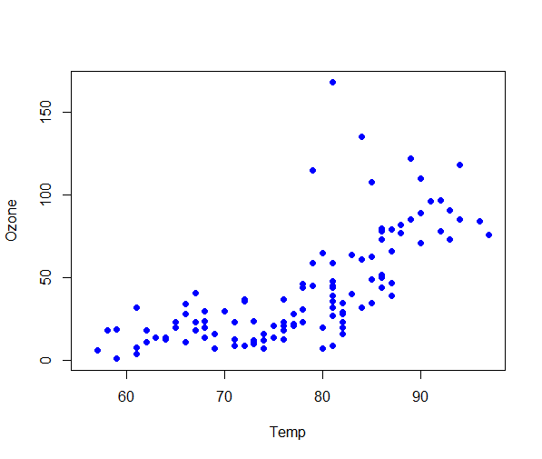
Correlation
Consider the two variables Ozone and Temp of the air quality data set.
We would like a measure of the tendency for these two variables to move together. That is, whether Ozone tends to be high (low) when Temp is high (low).
> plot(Ozone~Temp, data=aq, pch=16, col="blue")

Slide 71
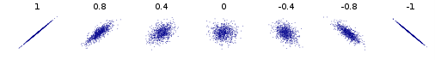
Correlation
R. A. Fisher had the idea of considering the two variables as vectors in an N-dimensional space
His measure, called correlation, is the cosine of the angle between the two vectors in this space
It takes values from -1 (perfect negative correlation) through 0 (no relationship) to +1 (perfect positive correlation)

Slide 72

Correlation
For any two vectors a, b, the dot product $a∙b$is given by
$a∙b=|a||b| cos⁡(θ$)
⇨ $\cos\left(θ\right)=\frac{a∙b}{\left|a\right||b|}$
Where the dot product is evaluated as $\sum_{i=1}^{N}{a_{i}b_{i}}$ and
$$\left|a\right|={\left\{\sum_{i=1}^{N}{{a_{i}}^{2}}\right\}}^{\frac{1}{2}}$$

Slide 73

The sample correlation coefficient
The sample correlation coefficient r:
$$r=\frac{\sum_{i=1}^{N}{{(x}_{i}−\overline{x}})(y_{i}−\overline{y})}{{\left\{\sum_{i=1}^{N}{{(x_{i}−\overline{x})}^{2}}\right\}}^{\frac{1}{2}}{\left\{\sum_{i=1}^{N}{{(y_{i}−\overline{y})}^{2}}\right\}}^{\frac{1}{2}}}$$
This is the cosine of the angle between two vectors
The magnitudes of the two vectors (the two factors in the denominator) are the standard deviations

Slide 74
Computing Correlations
In R use cor(). It takes vectors, matrices or data frames as arguments, so it can provide a correlation matrix of the correlation between any number of variables
In R use cor.test() for two vectors to obtain more details like confidence intervals.
In Excel use CORREL(). It takes two ranges as arguments.
To get the correlation between N variables in Excel you can use the correlation function in the Data Analysis Tool Pack. (This is an Add-In supplied with Excel. By default it is not installed. You need to go to File Options Add-Ins to install it first)

Slide 75

Correlation between Ozone and Temp
Notes:
hills = read.csv("hills.csv")
str(hills)
head(hills)
cor(hills)
cor(hills$dist,hills$time)
cor.test(hills$dist,hills$time)

Slide 76

Correlation between Ozone and Temp in EXCEL

Slide 77
Before we go …
When presented with a distribution of data DON’T just characterise it by the average
Try to get a handle on the WHOLE DISTRIBUTION
Display the WHOLE DISTRIBUTION, using
Histograms
Density plots
Boxplots
Trellis plots
and anything else that seems reasonable at the time
REMEMBER: You will make mistakes!
Error-free data analysis is as likely as bug-free software.
Get someone to check your results. Ask for a peer review.
ABOVE ALL – make sure your analysis is answering the right question!

Slide 78
Some R Commands To Get You Started
Appendix

Slide 79
R Data Types
R recognises the following basic data types:
‘character’ – a vector of character strings of varying (and unlimited) length
‘numeric’ – a vector of floating point numbers
‘integer’ – a vector of signed integers
‘logical’ – a vector of TRUE or FALSE values
‘complex’ – a vector of complex numbers
‘list’ – an ordered collection of R objects of possibly differing types
‘factor’ – a vector of categorical variables that take defined values. (A bit like enum in C++.) Used in statistical modelling, where it triggers the automatic creation of hidden dummy variables. Can be ‘ordered’

Slide 80
Loading Data into R
x = c(1,2,3,4) # Create a vector and put it in x
x = read.table(“C:\\temp\\my.data.txt”,sep=“\t”,header=T)
x = read.table(file.choose(),sep=“\t”,header=T)
Brings up an Explorer window so you can click on the file you want
x = read.csv(file.choose(),header=T)
A wrapper for read.table with sep=“,”
x = read.table(“clipboard”,header=T)
X = read.table(“http://fictitiousURL/datasets/my.data.dat”, header=T,sep=“\t”)
read.table is a wrapper for a more powerful function called scan(). If you have a file with complex structure, that read.table can’t handle, use scan()
Notes:
Notice that R uses the Unix ‘/’ instead of the Windows ‘\’ delimiter. The double slash ‘\\’ can be used instead of ‘/’.

Slide 81
Viewing and editing your data
ls()
Lists all objects in the workspace
rm(my.object)
Deletes an object
head(my.dataframe)
Shows the first 6 lines of a data frame
tail(my.dataframe)
Shows the last 6 lines of a data frame
View(my.dataframe)
Show the data frame in a grid-like window. Notice it’s View, not view. Very slow for large data sets and uses up a lot of memory.
my.edited.dataframe = edit(my.dataframe)
Invokes the editor

Slide 82
Saving Data
Objects can be saved as individual ‘.Rdata’ files using saveRDS(my.object,”C:\\users\\Blaise\\my.object.Rdata”)
Data can be saved as CSV files write.csv(my.data,”C:\\users\\Blaise\\my.data.csv)
At the end of session the whole workspace is saved as an .Rdata file

Slide 83
Getting Help with R
R comes with an HTML help file that will be displayed in your browser
help(anyfunction) or ?anyfunction use quotes for operators and special characters, e.g. help (“%*%”) or ?”%*%” (%*% is the operator for matrix multiplication)
??”any string” to search the R help file for any string (“” when string contains blanks)
StackOverflow.com – for programming questions
CrossValidated.com – for statistics questions
The R search engine http://www.rseek.org/
R help mailing list at stat.ethz.ch/mailman/listinfo/r-help
But only if you’re desperate!
Google, with R as the first search term
Google R style guide – how to write good R code
http://google-styleguide.googlecode.com/svn/trunk/google-r-style.html

Slide 84
R Packages
R has a core language and additional functionality in the form of packages (see at the end of this deck for a curated list)
When installed R has a number of useful packages installed
Additional packages can be securely downloaded from within R
install.packages(‘ggplot2’) downloads the package ggplot2 and checks its MD5 checksum to make sure it has not been tampered with
You will be asked to choose a mirror site. Pick one in the UK. If it’s busy, pick another one.
library(ggplot2) loads the package ready for use

Slide 85

Read this free eBook: http://r4ds.had.co.nz

Slide 86
References

Slide 87
Useful R Packages
Hadley Wickham’s tidyverse package contains a comprehensive set of packages for data manipulation (dplyr), graphics (ggplot2) and a better version of data frames (tibble).
The data.table package is optimised for handling large data sets.
Jenny Bryan, Statistics Professor in Vancouver, maintains a GitHub repository of useful R software and is active on Twitter.
Sharon Machlis from Computerworld has an article about useful R packages for data import, wrangling and visualisation (accessed 31/07/2018). https://www.computerworld.com/article/2921176/business-intelligence/great-r-packages-for-data-import-wrangling-visualization.html

